Slide 1
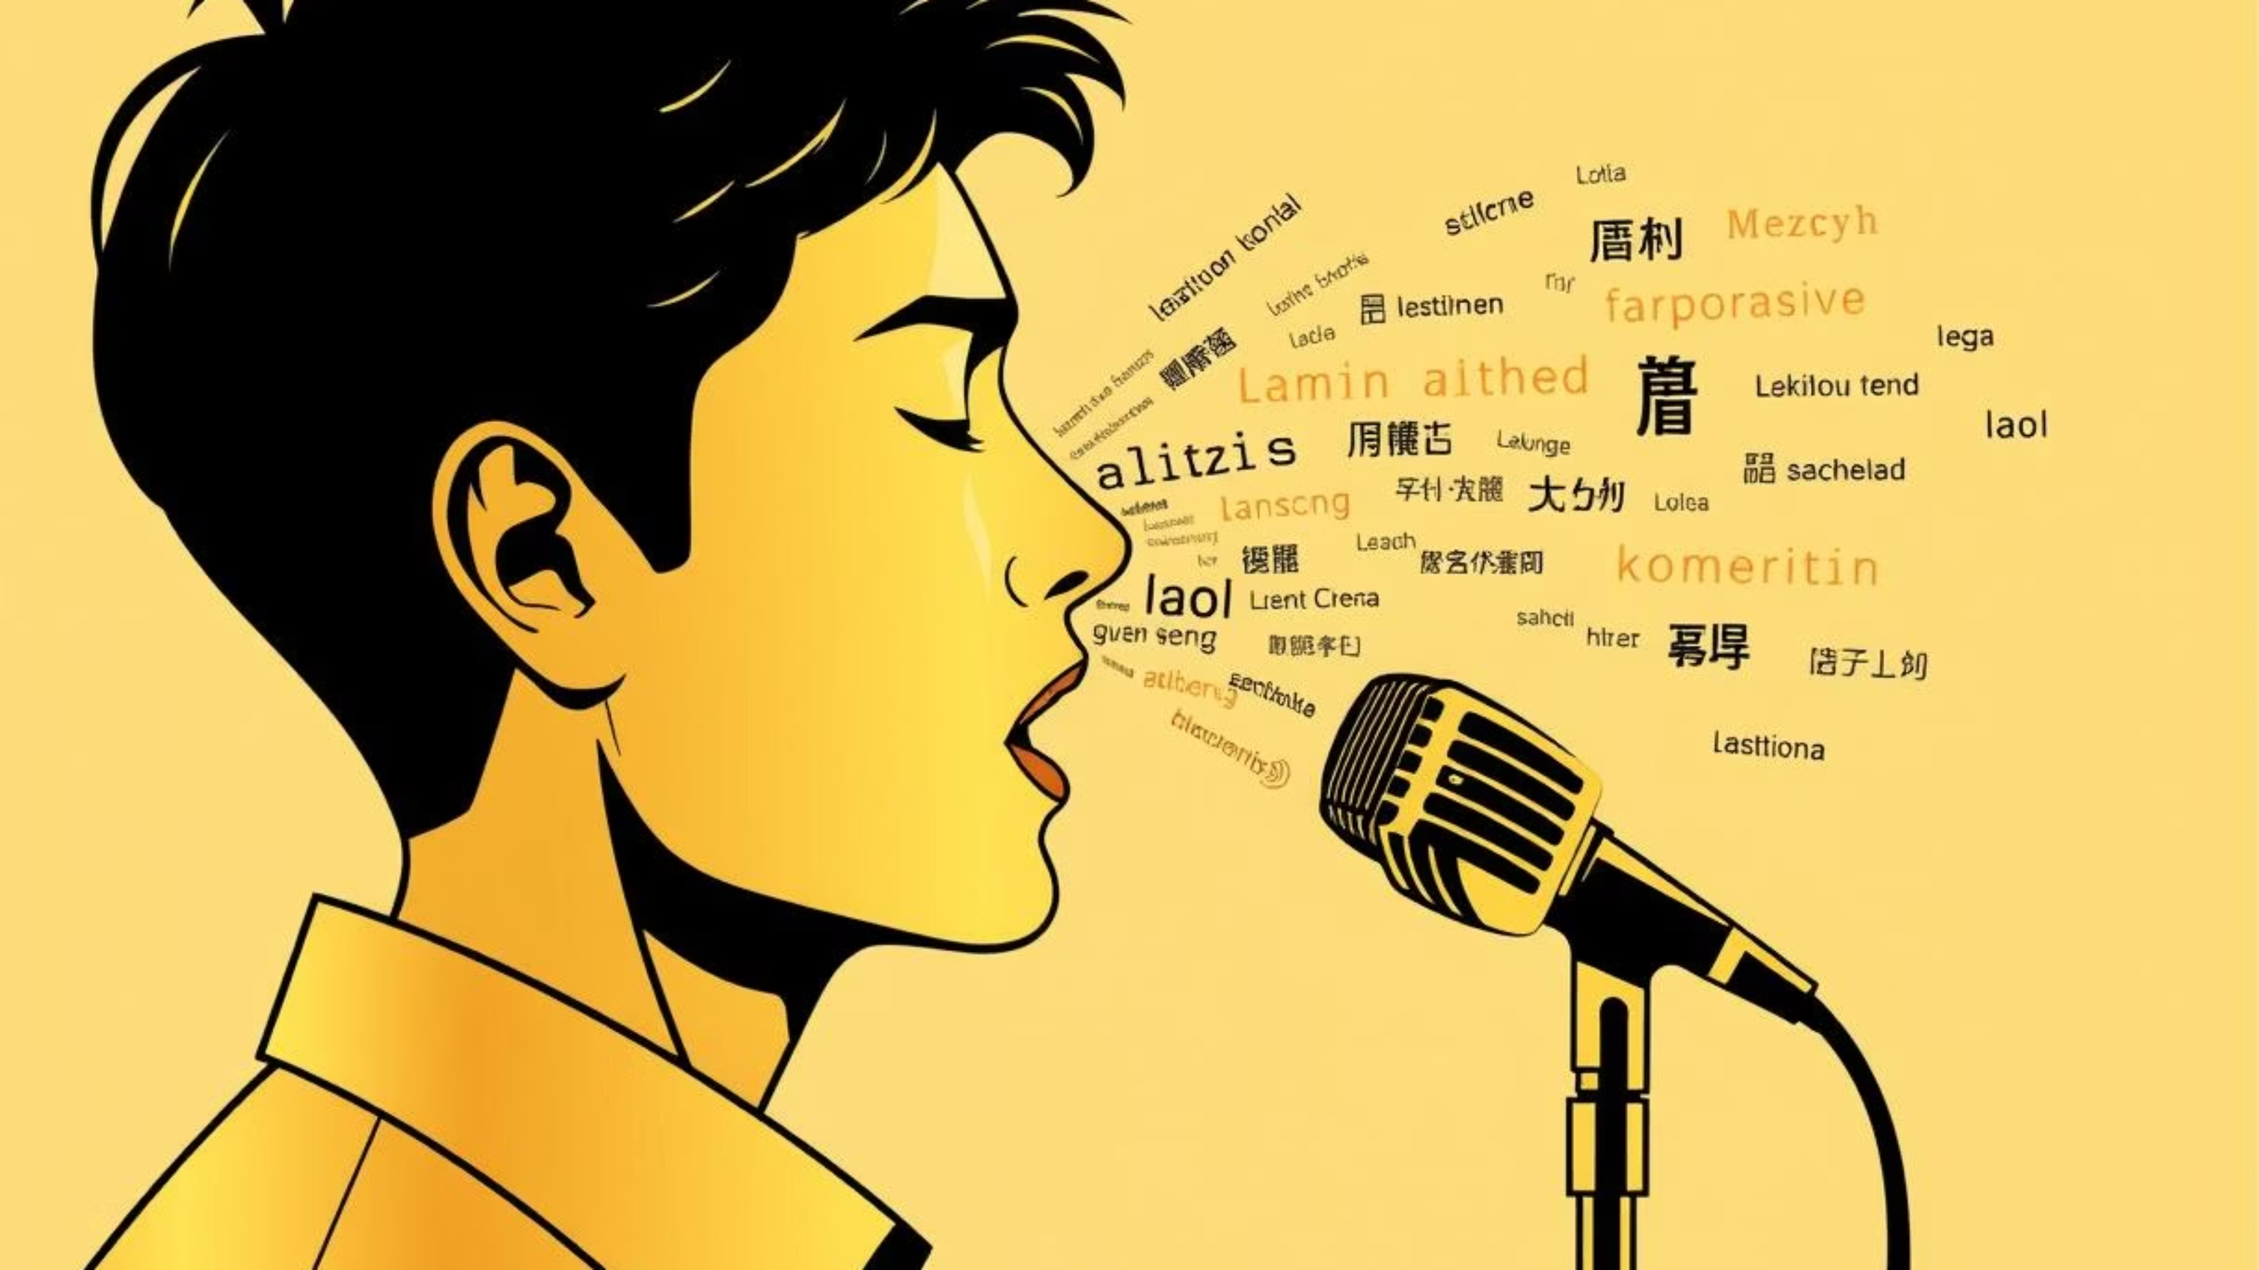
Voice Translation using Gen AI and Whisper
A live demonstration of an end-to-end voice translation pipeline

Slide 2
GROUP MEMBERS
NAME: AKSHARA SRIVASATAVA
NAME: APRAJITA RANJAN
NAME: BHUMI UPADHYAY
NAME: SOMIYA NAMDEO
REG NO: 23BAI10585
REG NO: 23BAI11399
REG NO: 23BAI10617
REG NO: 23BAI10689

Slide 3
The Problem Statement
Challenge: The need for real-time and accurate translation of spoken content.
Goal: To build an application that can:
Accept an audio file.
Transcribe the spoken words into text.
Translate the transcribed text into a different language.
Provide the transcript and translation to the user.

Slide 4
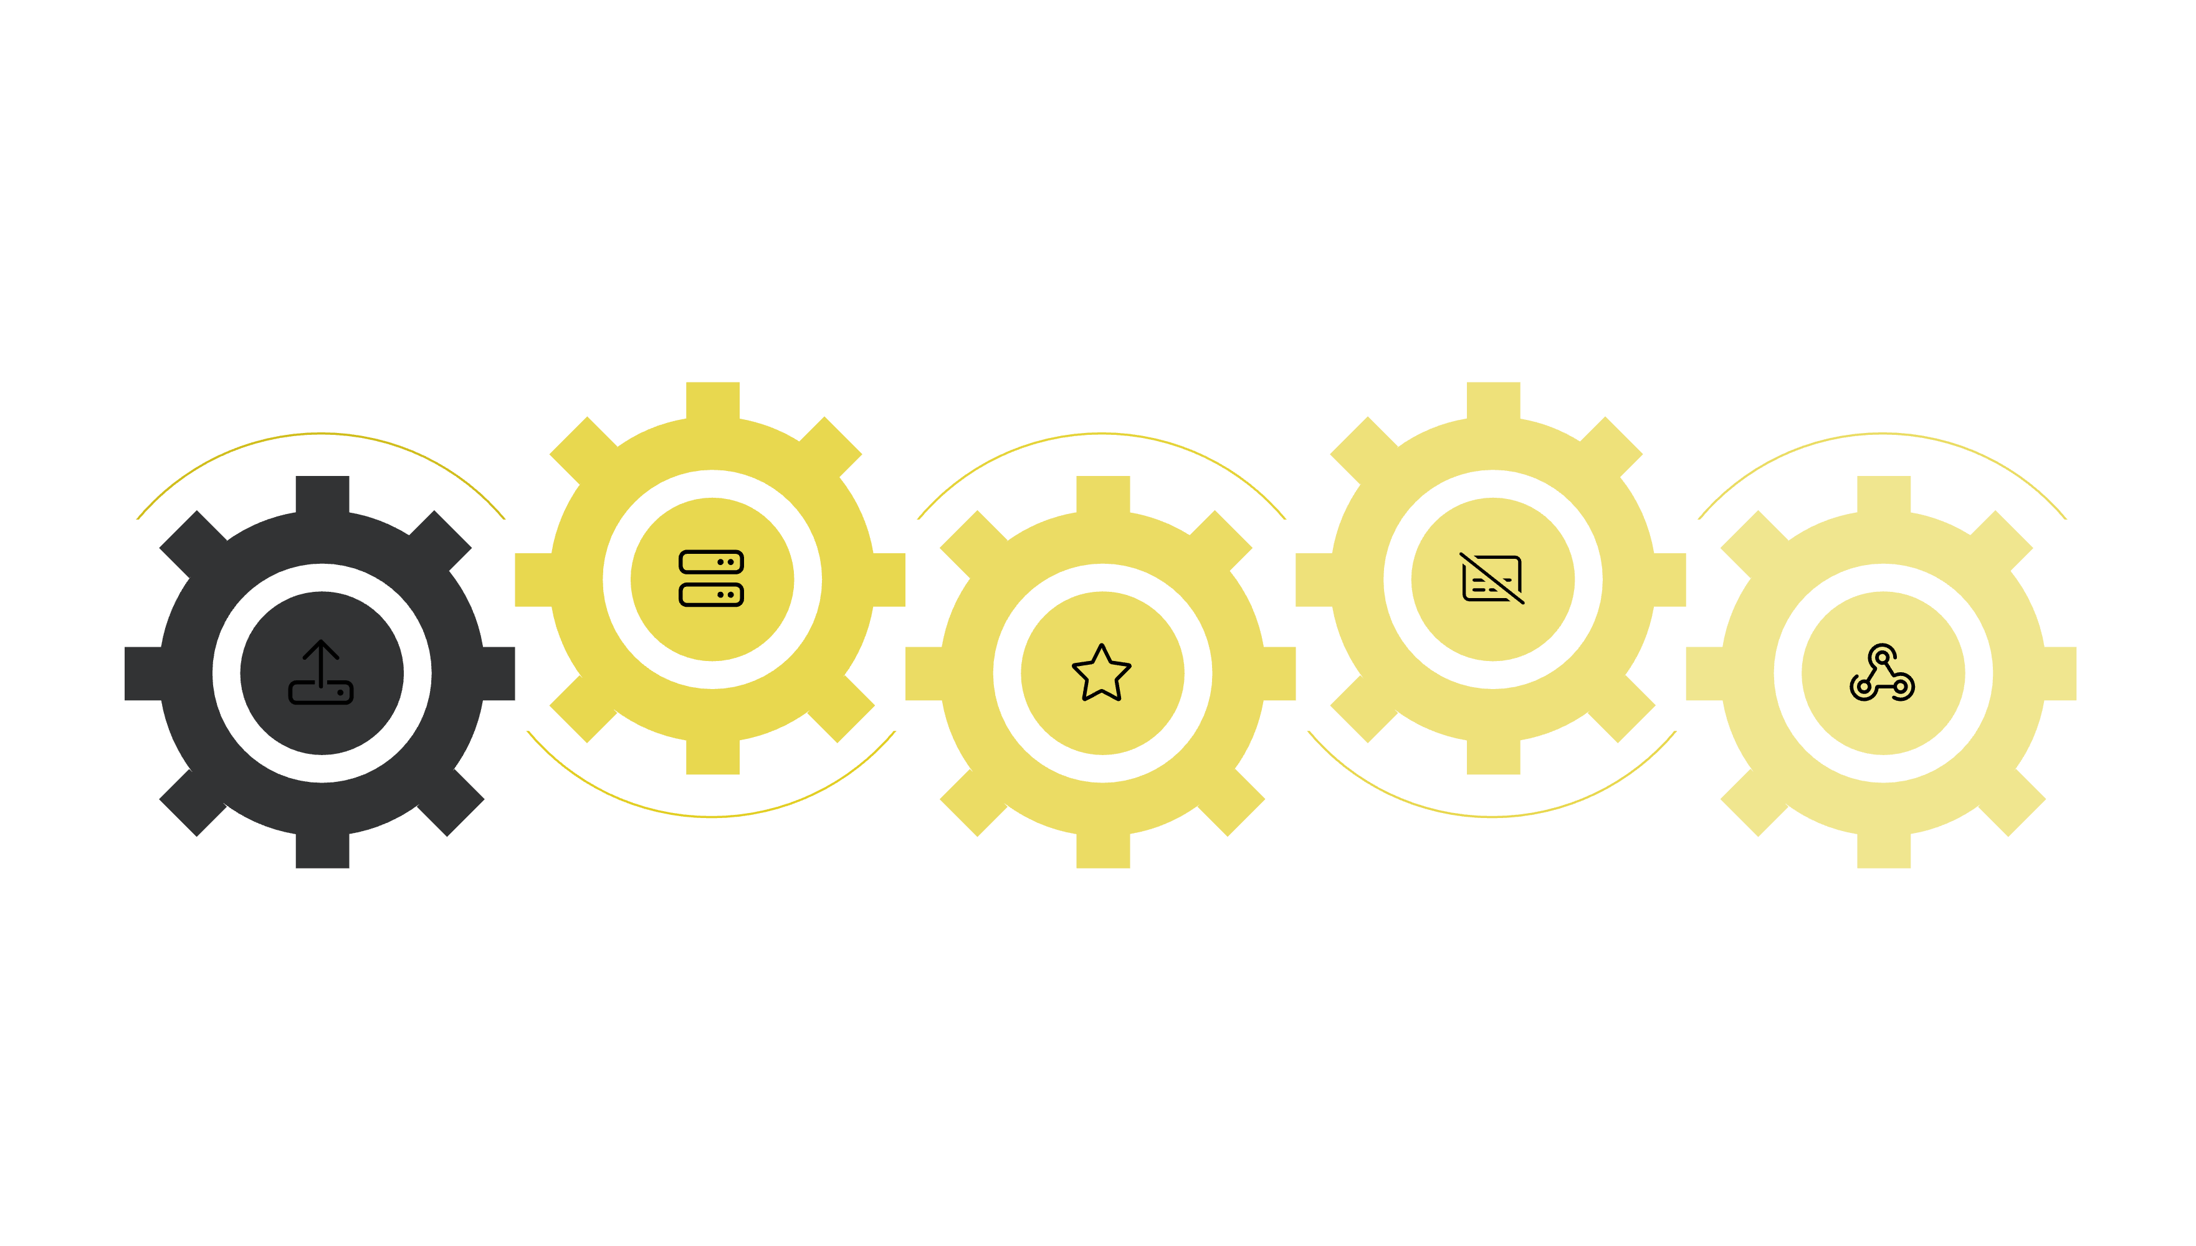





High-Level Architecture Diagram
Flask Server
Gen AI Translation
Receives and routes request
Translate transcript
User Uploads
Whisper Model
Flask Response
Audio file submission
Transcription of audio
Return JSON to user

Slide 5


Key Technologies Used
Flask
Whisper Model
Facebook M2M100 (Gen AI Translation Model)
A lightweight Python web framework used to create the web server and handle API requests.
Function: Automatic Speech Recognition (ASR). Purpose in the app: Transcribes the audio file into a text transcript. Model Size: The code uses the "base" model.
Function: Machine Translation. Purpose in the app: Translates the English transcript into a target language. Model Size: The code specifies the m2m100_418M model.
PyTorch
Hugging Face transformers Library
The deep learning framework used by the Gen AI translation model for efficient computations.
Provides the pre-trained M2M100 model and tokenizer, simplifying the implementation.

Slide 6
Code Walkthrough - Server Setup (app.py)
Key Imports:
Routes:
Flask, request, jsonify, whisper, transformers.
@app.route('/', methods=['GET', 'POST']): Defines the main endpoint.
Model Loading:
GET request: Renders the index.html file (the user interface).
The script pre-loads the Whisper model and the M2M100 model/tokenizer on startup.
POST request: Handles the file upload and processing.
This is a crucial step to avoid delays on each user request.

Slide 7
Code Walkthrough - Processing a Request (POST method)
01
02
File Handling:
Transcription:
The request.files.get('file') method retrieves the uploaded audio
file
whisper_model.transcribe(file_path) is called to transcribe the audio.
The file is temporarily saved to the static folder.
The result is a dictionary containing the "text" and the detected "language".
03
04
Translation:
Cleanup & Response:
The translate_with_gen_ai function is called with the transcript and the target language code.
The temporary audio file is deleted using os.remove().
A JSON response is returned containing the transcript, translation, and other metadata.
This function sets the source language to English ( tokenizer.src_lang = "en").
It then uses model.generate() to produce the translated output.

Slide 8
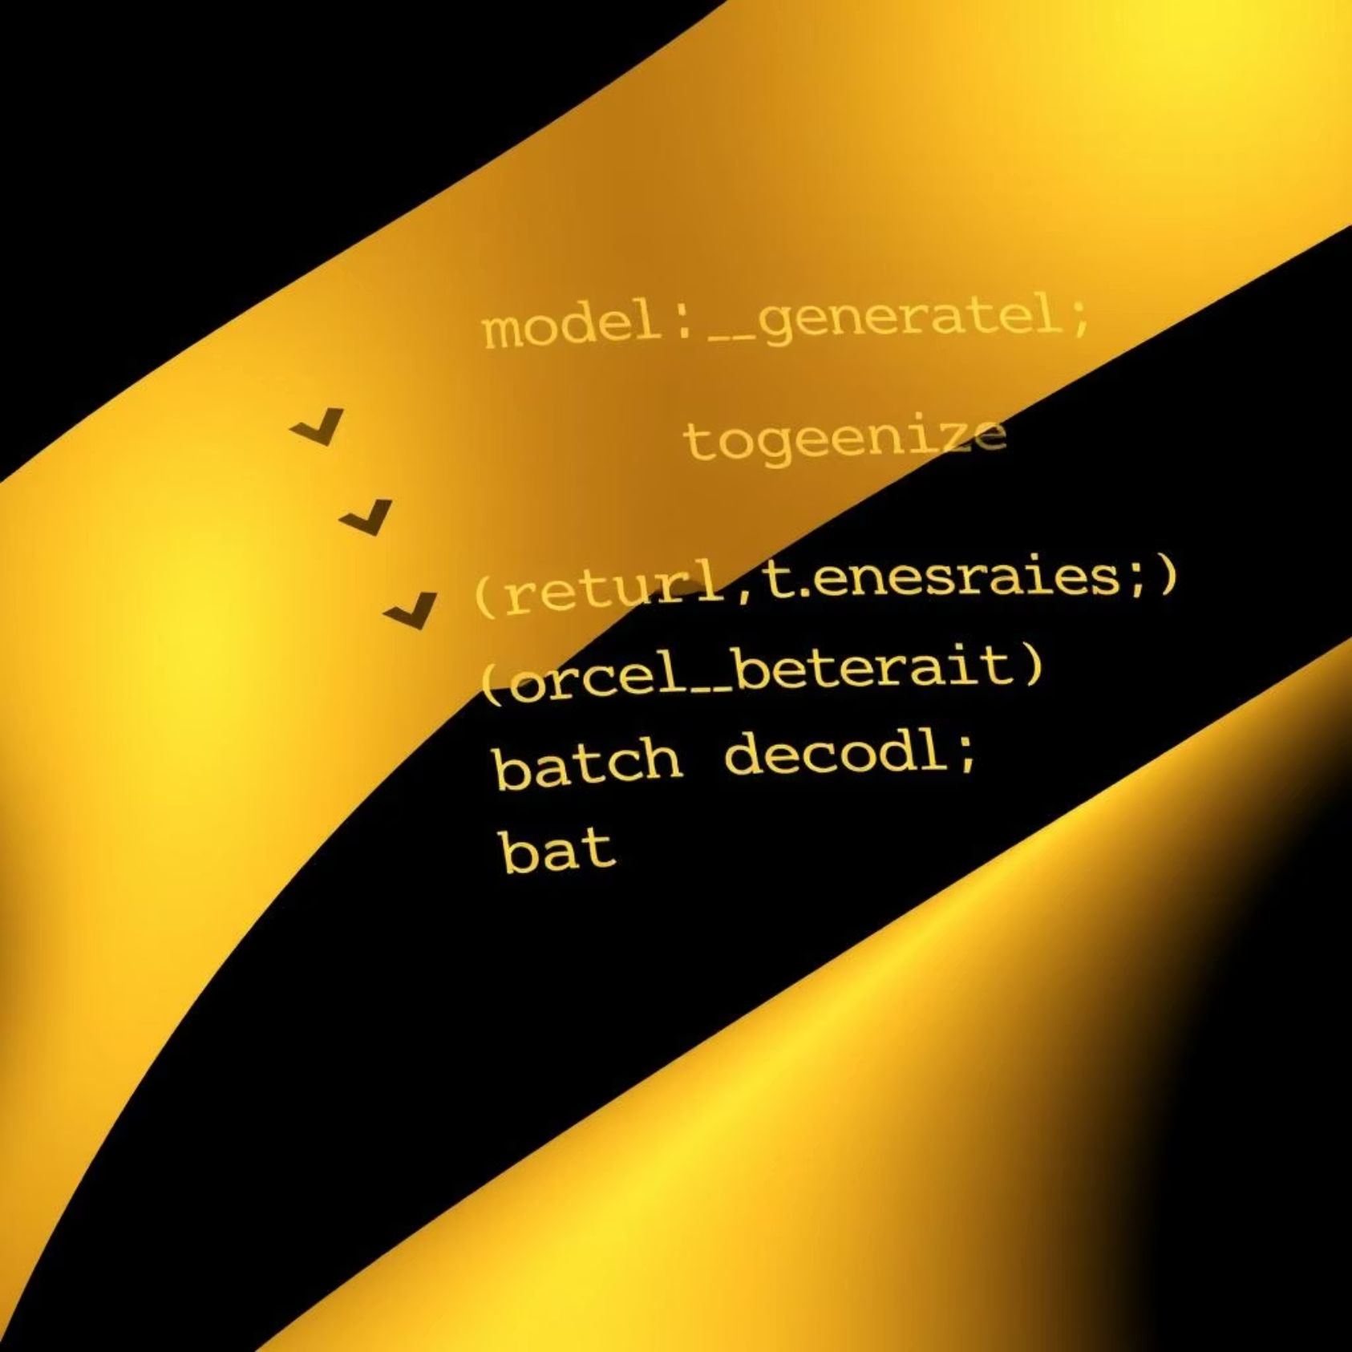
M2M100 Translation Function (translate_with_gen_ai)
Tokenizer:
tokenizer(text, return_tensors="pt"): Encodes the input text into tensors suitable for the model.
Model Generation:
model.generate(...): The core of the translation process.
forced_bos_token_id: This parameter tells the model which language to translate to, based on the user's selection.
Decoding:
tokenizer.batch_decode(...): Converts the model's output tokens back into human-readable text.

Slide 9
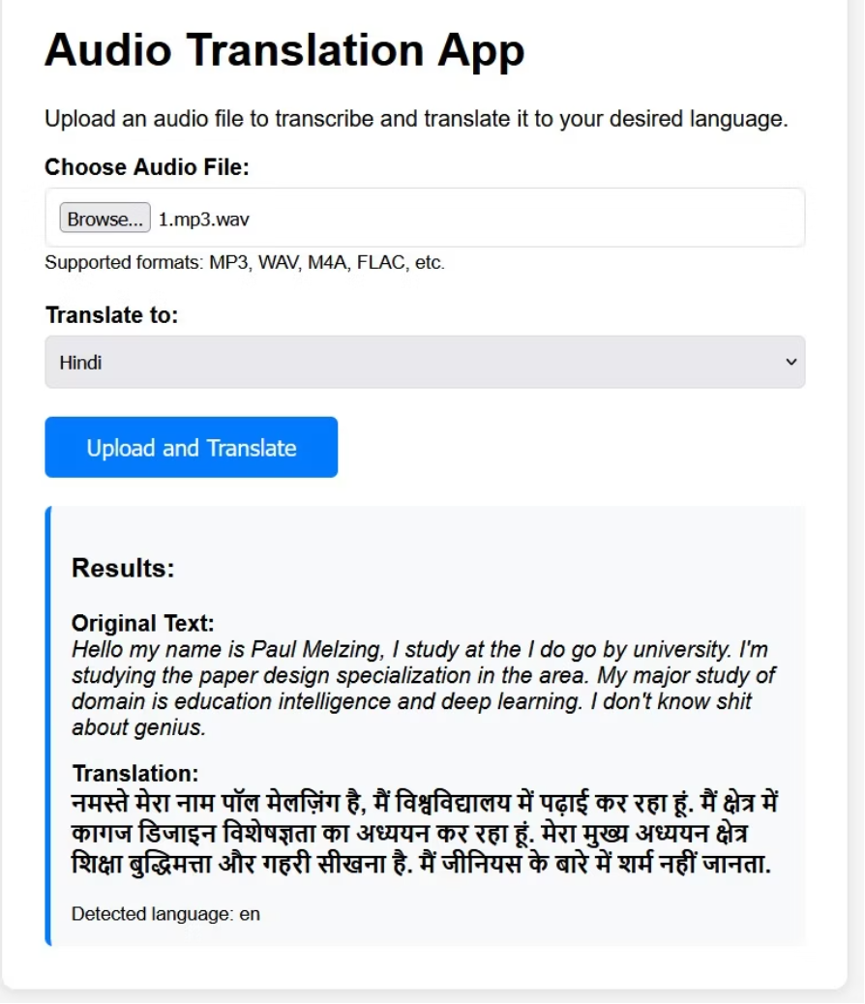
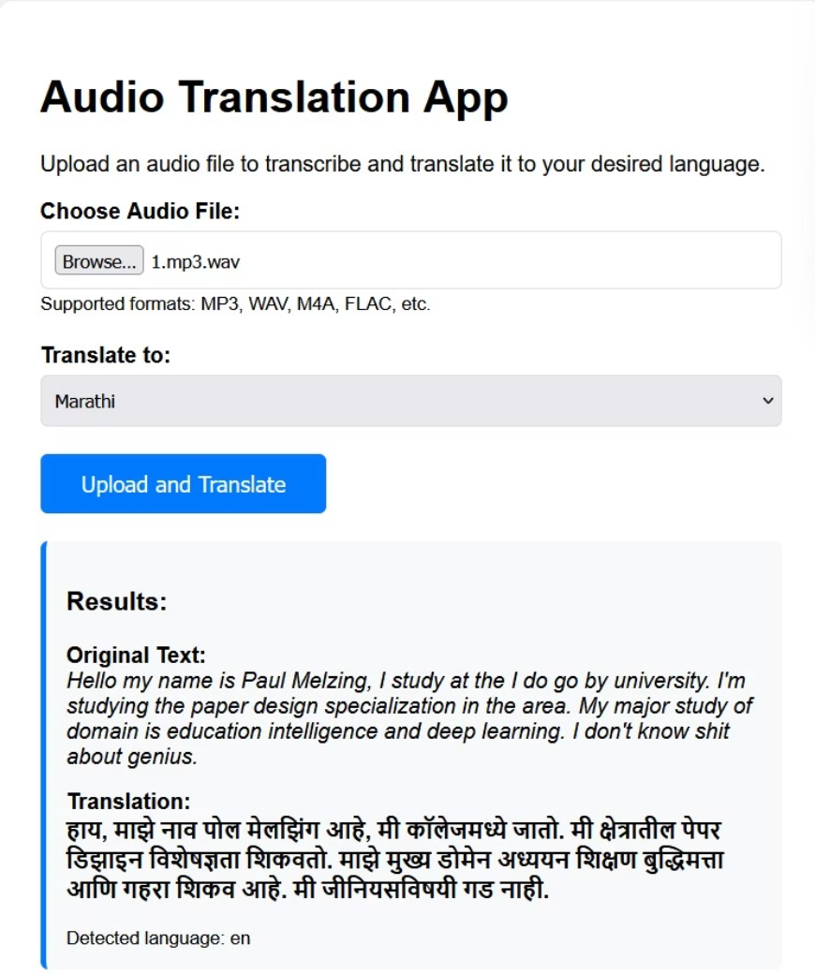
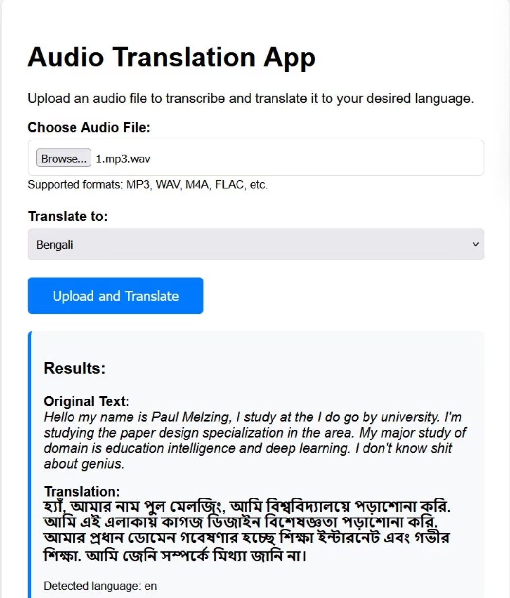
RESULT PANEL(ENG - INDIAN LANG.)
Translates
Translates
Translates
Eng-Hindi
Eng-Bengali
Eng-Marathi

Slide 10
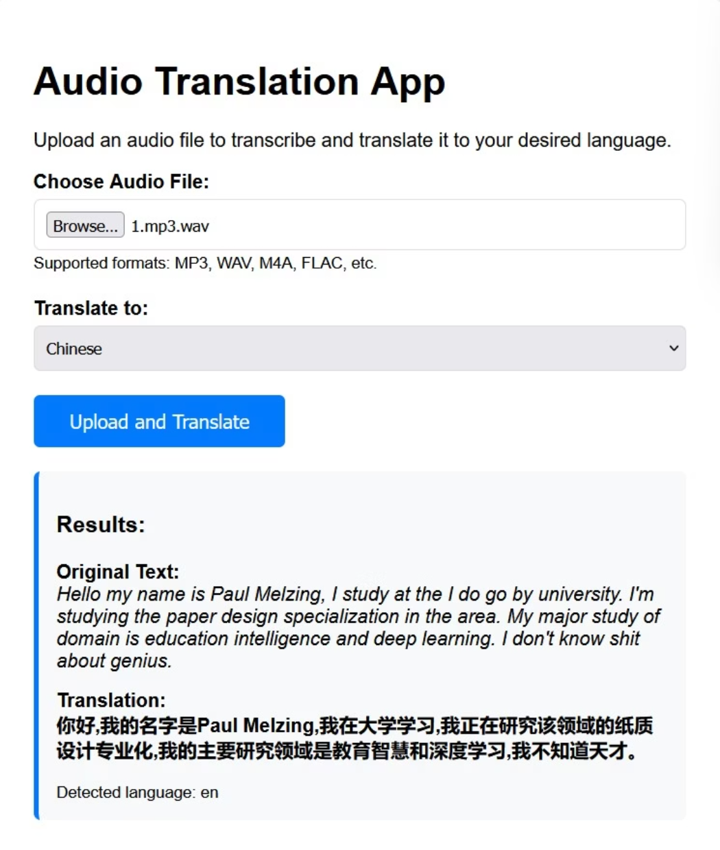
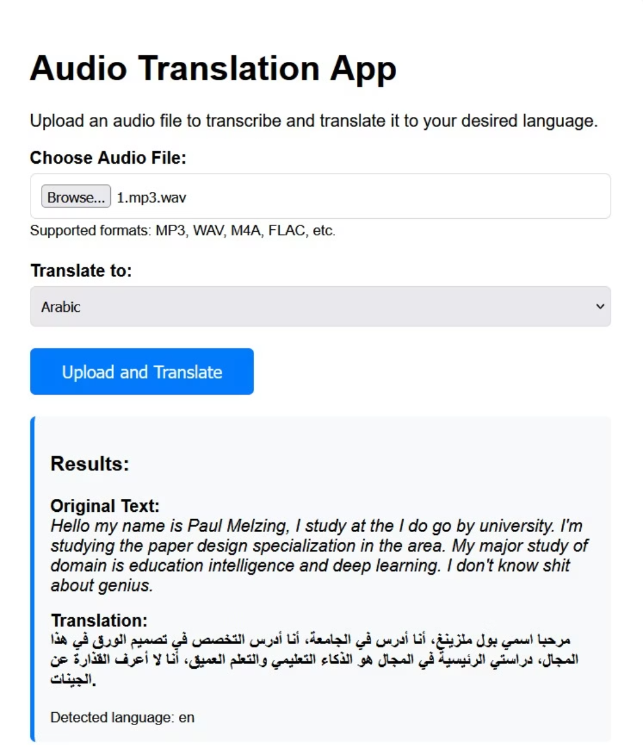
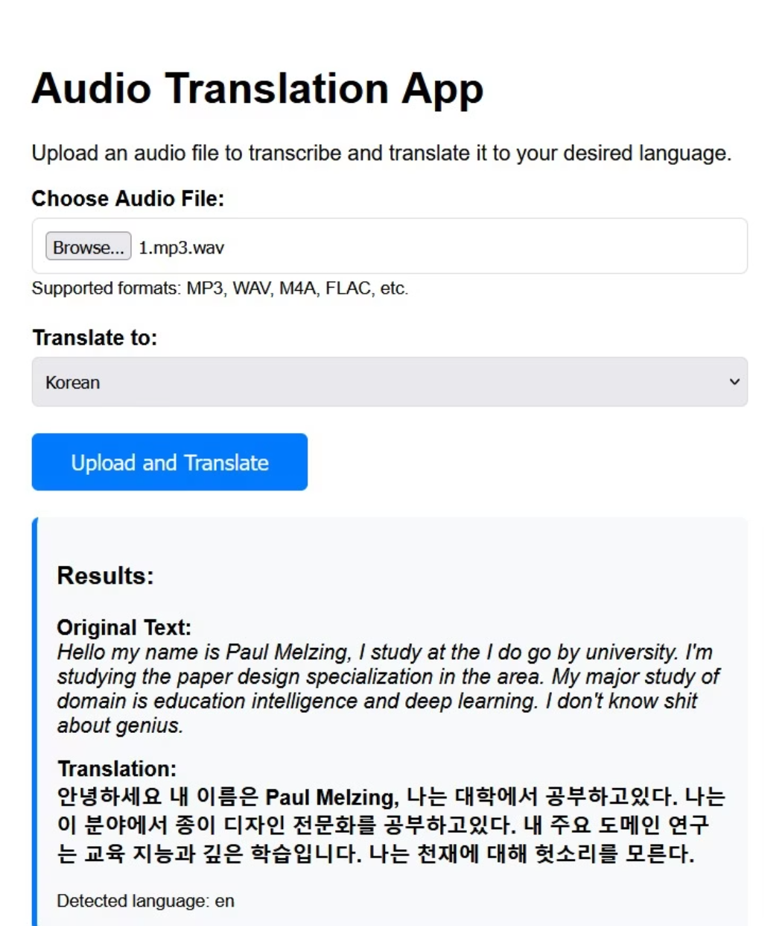
RESULT PANEL(ENG - INTERNATIONAL LANG.)
Translates
Translates
Translates
Eng-Chinese
Eng-Arabic
Eng-Korean

Slide 11
Language Support & Limitations
Supported Languages:
Current Limitation:
The application currently supports 16 languages as defined in the LANGUAGE_CODES dictionary: Spanish, French, German, Italian, Portuguese, Russian, Chinese, Japanese, Korean, Arabic, Hindi, Bengali, Tamil, Telugu, Marathi, and Gujarati.
The translation pipeline assumes the input audio is in English, as the tokenizer.src_lang is hardcoded to "en". A potential improvement would be to use the language detected by Whisper as the source language for the translation model.

Slide 12
Potential Improvements
Real-time Streaming
Modify the application to process audio streams instead of full file uploads for a more responsive user experience.
Multiple Source Languages
Use Whisper's detected language to dynamically set the source language for the translation model.
Whisper Translation
Explore using Whisper's built-in translation feature for a simpler pipeline, although the M2M100 model is specifically designed for a wider range of language pairs.
Front-end enhancements
Create a more user-friendly interface with progress bars and clear error messages.
Deployment
Discuss options for deploying the application on cloud platforms like AWS, Google Cloud, or Azure, and the considerations for running large models in a production environment.

Slide 13
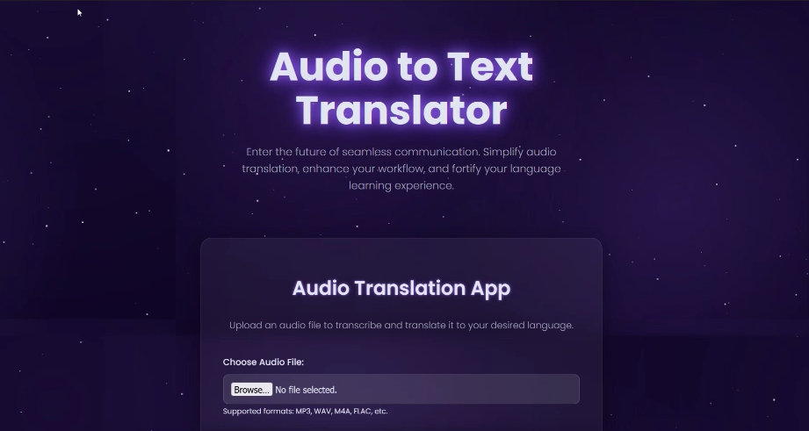
PRESENTING OUR PROJECT LIVE

Slide 14
THANK YOU

